Slide 1
Communities Demo
James W. Garret
Christopher Bednarz
Eric Anderson
Mason Holley
Zoe Chamlee
Rishabh Tewari

Slide 2
Reminder of Our Project
Massive Connectivity Online
Distant relationships
Local Area Community App
Use our app for News, Posts and Events
Limited Scope

Slide 3
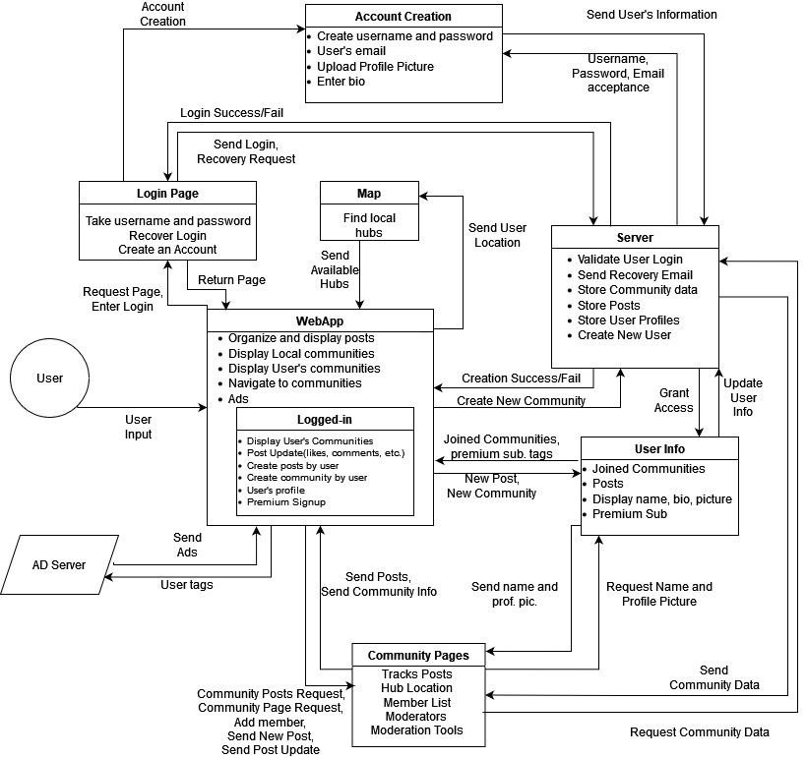
Level 3 Diagram

Slide 4
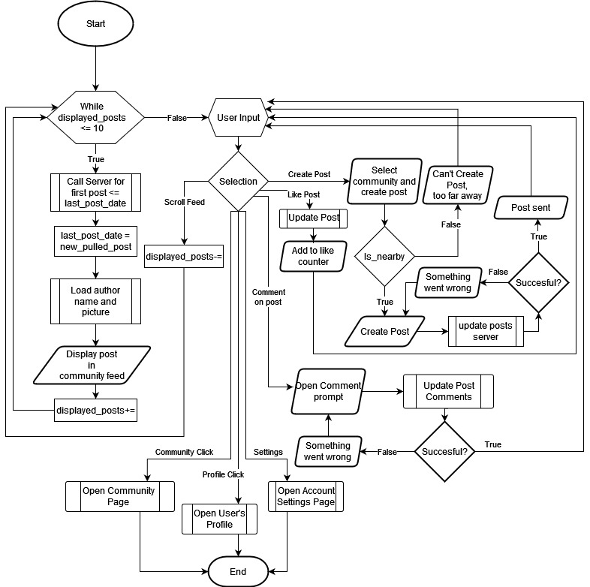
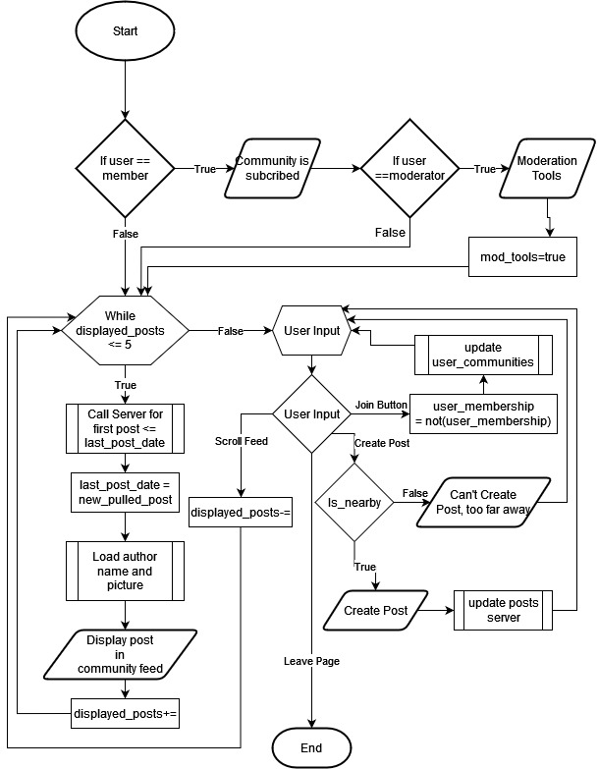
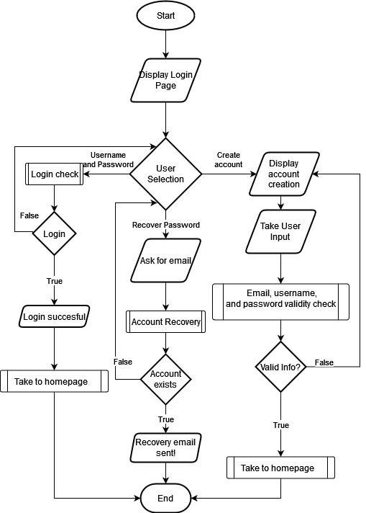
Flowcharts
Login and Account Creation
WebApp Homepage
Community Page

Slide 5
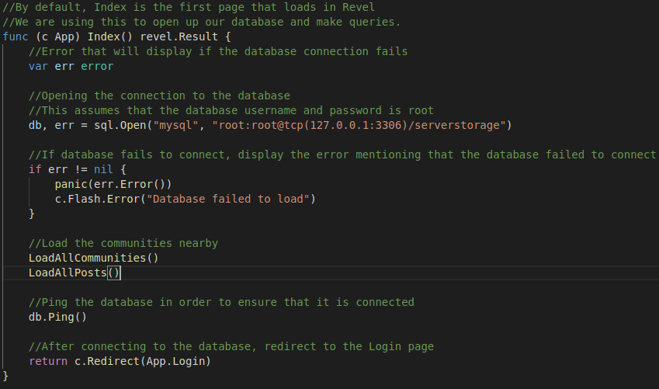
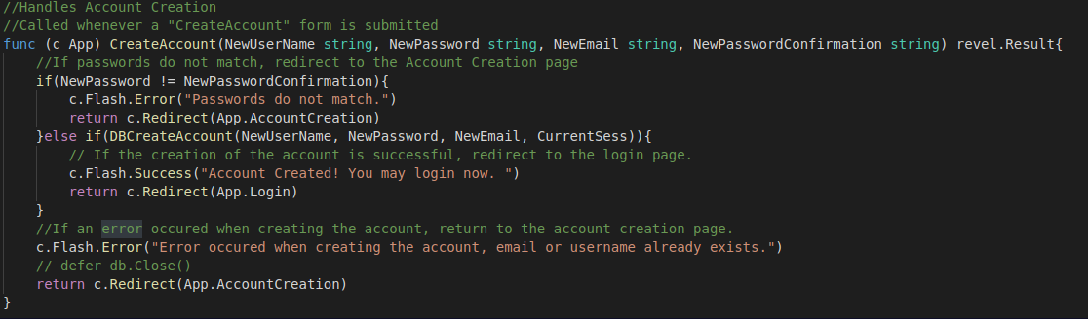
Code Blocks

Slide 6
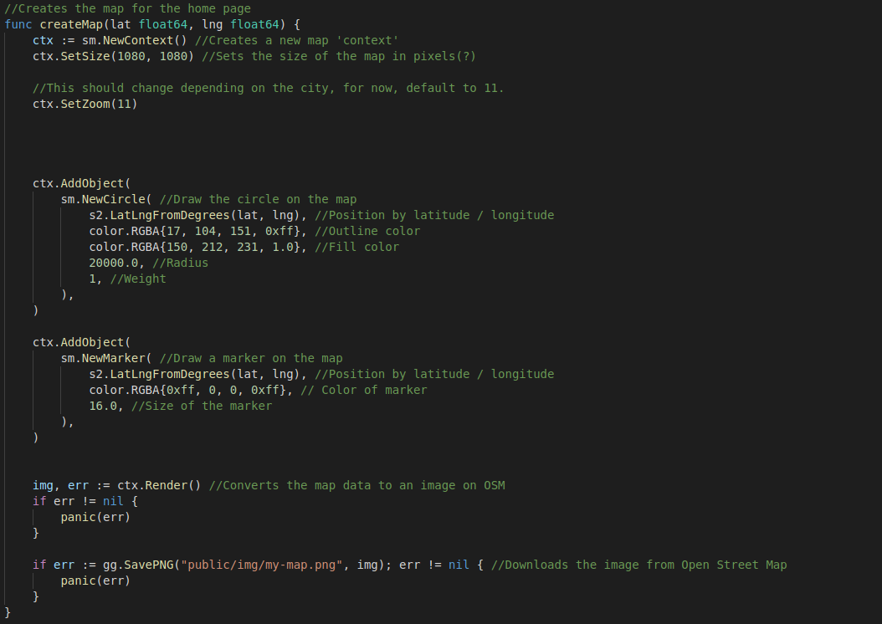
Code Blocks

Slide 7
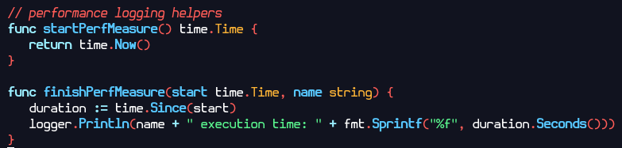
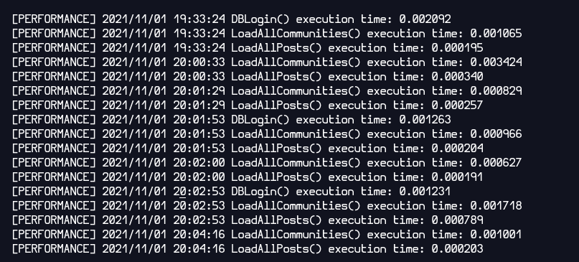
Performance Metrics
DBLogin(): 0
LoadAllCommunities(): 1.38ms
LoadAllPosts: 0.31ms

Slide 8
Project Demonstration
A short demo of our working application.

Slide 9
Revel Issues

Slide 10
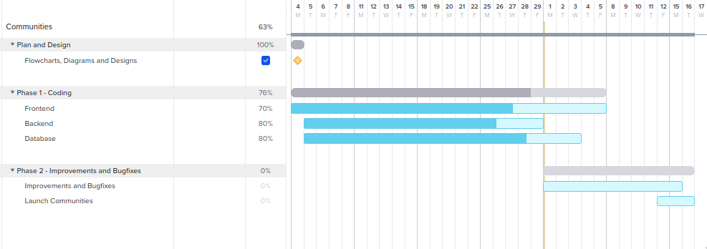
Updated Gantt chart

Slide 11
Standards and Safety
ISO - Standard password encryption.
All sensitive data such as our passwords and user geolocation data will be encrypted.
GDPR - Getting permission to keep user info and no selling
The app needs to use sensitive data so we will maintain user anonymity while serving relevant ads and using the app’s location features
ANSI - Working to generally improve public health through the app
Fostering in person interaction between communities

Slide 12
Future Plans
Better showcase Community Location
Improve Community page scalability
Interactable Map
Event Creation and Planning
Improved Frontend Looks

